Slide 1
Bi Visibility Day September 23
Student Health & Human Services
Office of Human Relations, Diversity & Equity
June 2022

Slide 2
Welcome Do you prefer:
Salty
Sweet

Slide 3
Objectives
Learn about the history of Bi Visibility Day
Review the timeline of public recognition of Bi Visibility Day.
Discuss the importance of honoring our identities.

Slide 4
What is Bi Visibility Day?
Bi Visibility Day is an annual holiday celebrated on September 23rd.
Purpose: to recognize and celebrate bisexual people, the bisexual community and the history of bisexuality.
Notes:
https://youtu.be/DzflAT5xLrA (3:16)

Slide 5
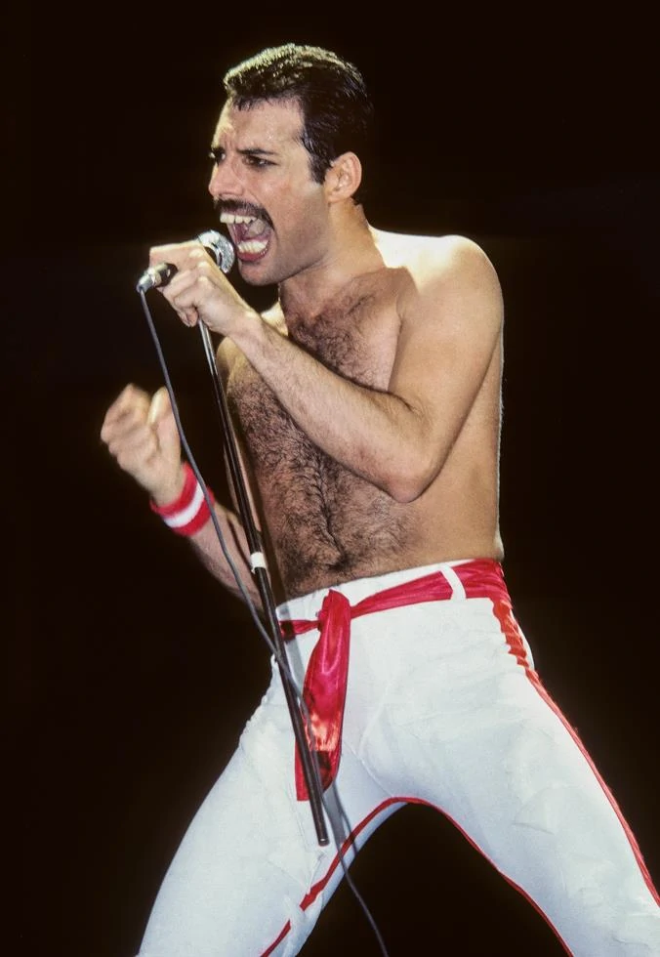
Why September 23?
This important day was initiated by three bisexual rights activists in 1999: Wendy Curry, Michael Page, and Gigi Raven Wilbur who picked the date in a unique way:
Says Wendy Curry: "We were sitting around at one of the annual bi conventions, venting and someone – I think it was Gigi – said we should have a party. We all loved the great bisexual [singer] Freddie Mercury . His birthday was in September, so why not Sept? We wanted a weekend day to ensure the most people would do something. Gigi's birthday was Sept 23rd. It fell on a weekend day, so, poof! We had a day."

Slide 6
Reflection
The way the activists chose the date for Bi Visibility Day is super unique!
Do you think they could have gone about it another way?

Slide 7
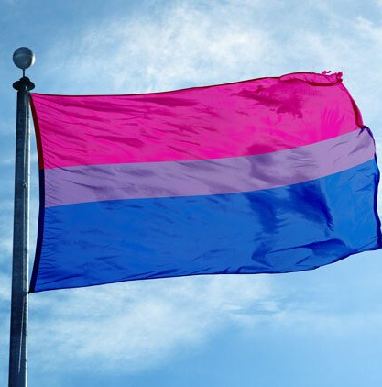
The Bisexual Pride Flag
The bisexual pride flag was designed by Michael Page in 1998 to give the bisexual community more visibility, similar to the gay pride flag of the larger LGBTQ+ Community.
Pink represents attraction to the same gender.
Blue represents attraction to the other gender.
Purple, represents attraction to 2 or more genders.

Slide 8
Official Recognition of Bisexual Visibility Day
18 Sep. 2012
On September 18, 2012, Berkeley, California, became what the first city in the U.S. to officially proclaim a day recognizing bisexuals.
23 Sep. 2012
The Berkeley City Council unanimously and without discussion declared September 23 as Bisexual Pride and Bi Visibility Day.

Slide 9
Reflection
Bi Visibility Day started in 1999. Berkeley became the first city to recognize this day in 2012.
Why do you think it took so long for this date to get recognized publicly?

Slide 10
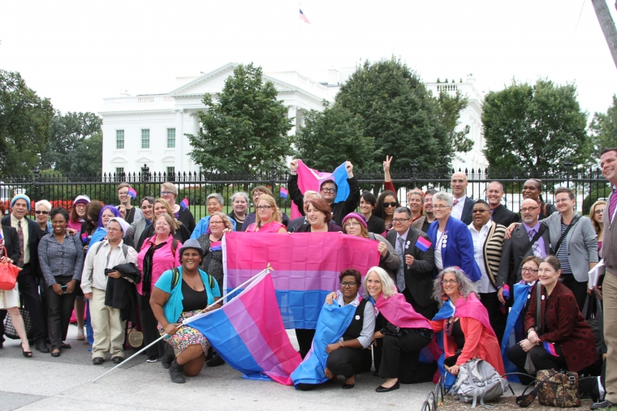
Bisexual Visibility at the White House
In 2013, on Bisexual Visibility Day, the White House held a closed-door meeting with almost 30 bisexual advocates.
The purpose of this meeting was to discuss issues of specific importance to the bisexual community.
This was the first bi-specific event ever hosted by any White House administration.

Slide 11
All About Inclusion
Many individuals and organizations currently refer to as Bisexuality+ Day.
The inclusion of the "+" sign ensures the inclusion of the broader bi+ community of people who prefer to use terms to such as pansexual, polysexual, omnisexual, fluid, or queer to describe their affectional orientation

Slide 12
Check Out
If you could create a flag to honor something unique about your identity, what would you honor – and how would the flag look?

Slide 13
Teacher Feedback Survey
Notes:
Teacher, please scan the QR code or click the link below to complete a quick feedback survey:
https://forms.office.com/r/i9UqyyxzTT

Slide 14
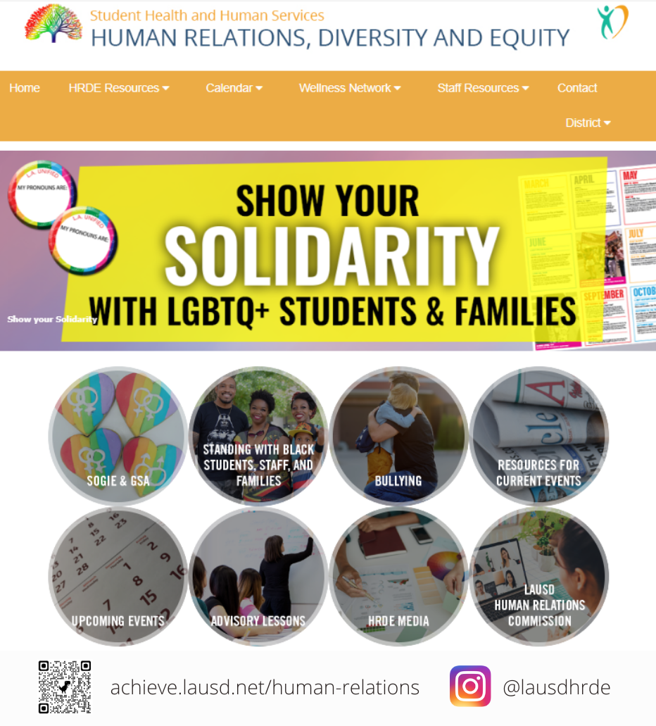
Human Relations, Diversity and Equity

